Slide 1
Effective Communication
Week 1
Introduction

Slide 2
Weekly Course Outline
Week 1 – Introduction and communication skills audit
Week 2 – Emotional Intelligence
Week 3 – NLP: rapport building and listening skills
Week 4 - Johari Window and Personality types
Week 5 – Assertive Communication and Transactional Analysis
Week 6 - Assignment Essentials week
Week 7 – Presentation skills workshop
Week 8 – Small group presentation and personal feedback
Week 9 – Interviews workshop
Week 10 – Interview panel week
Week 11 – Summary of course, skills audit revisit and evaluation
Notes:
SD

Slide 3

Module Learning Outcomes
Half module (10 CATS points)
11 weeks of Face to Face – 22 hours
(100 hours (inc. self learning)
100% coursework (Portfolio)
40% minimum pass mark
LO1 Appraise and formulate different inter-personal communication strategies
LO2 Apply tools and techniques for effectively managing communication in different situations
LO2 Write a self-reflective journal, recognising personal strengths and areas for development.
Notes:
SD

Slide 4
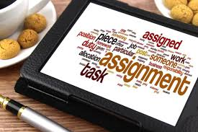
The Assignment
3 tasks (word count - 1750 words)
University 10% +/- margin applies.
Part 1 (Learning Outcome 1) From the following communication theories - Choose 2 and evaluate their value; outline their strengths and weaknesses (Neuro-Linguistic Programming, Emotional Intelligence, Transactional Analysis, Johari Window).
Part 2 (Learning Outcome 2) Discuss 2 communication activities (in class or external) and comment on what went well and what you could improve on. Activities could include - group presentations, individual presentations, interview experience, video or telephone interview or video CV
Part 3 (Learning Outcome 3) Reflecting on your experiences, outline 1 communication strength and 2 areas of weakness that you could develop in the next year. Explain what steps you will take to improve these communication weaknesses.
Notes:
SD

Slide 5
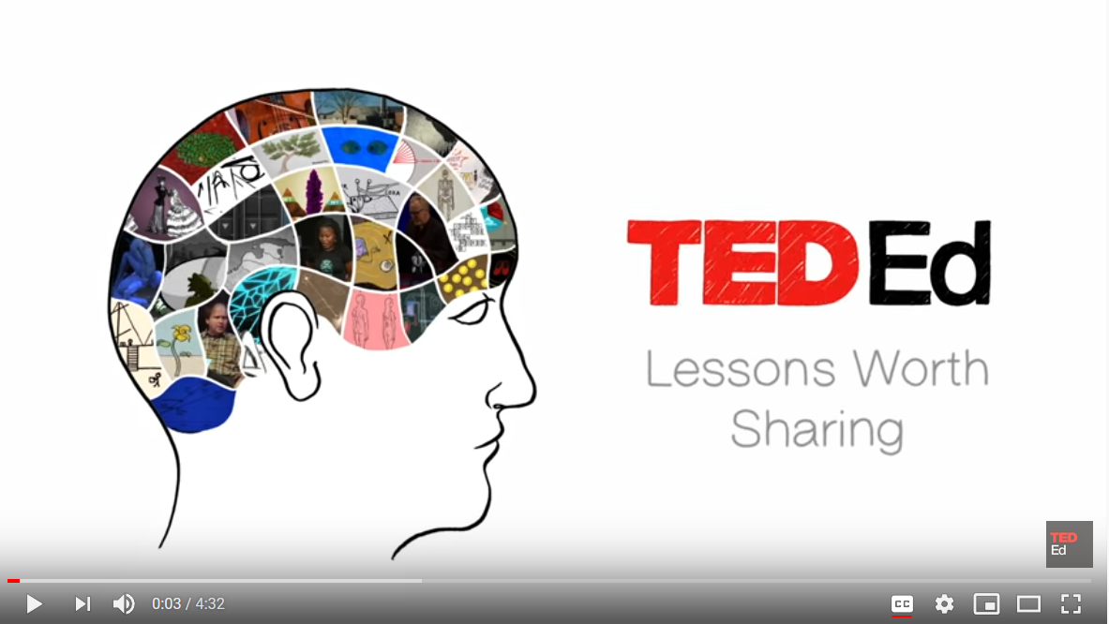
https://www.youtube.com/watch?v=gCfzeONu3Mo

Slide 6
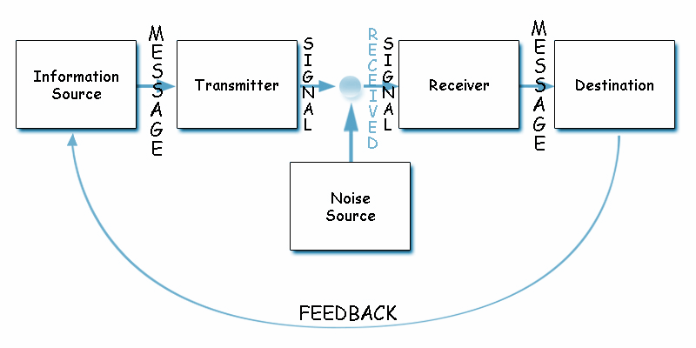
Shannon and Weaver Model Of Communication 1948

Slide 7
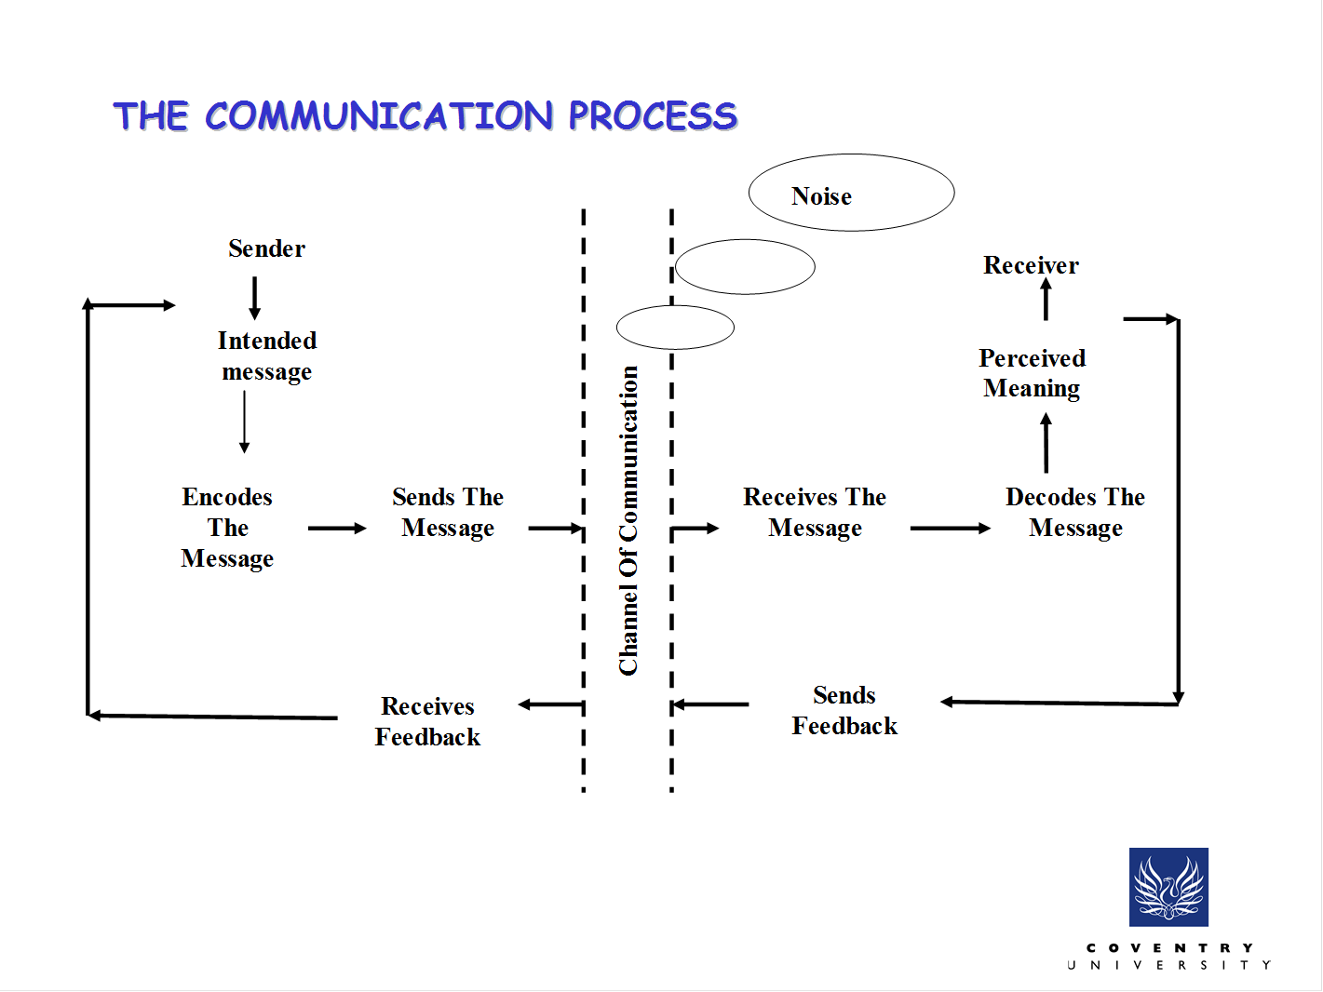

Slide 8
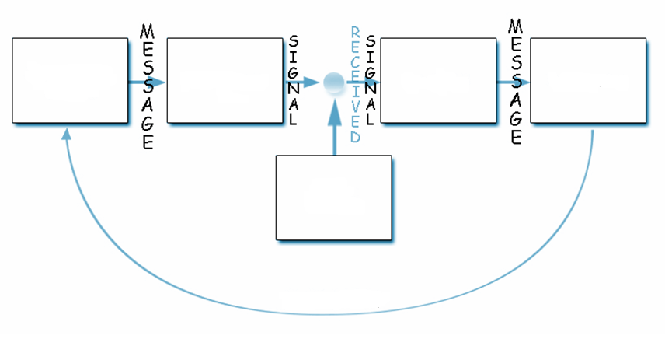
Email
converted
into
binary data
Binary data
converted
into email
message
Receiver
reads the
Email
message
Composes
an email
message
Email
message
ending in
Spam folder
Reply email message
Shannon and Weaver Model Of Communication 1948

Slide 9
Effective Communication
1
Message is sent by a sender
Message is received by an intended receiver
2
Message is understood by the intended receiver
3
The sender is sure about the message received and understood.
4

Slide 10
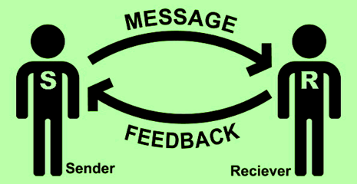
Effective Communication
MESSAGES SENT:
Verbal–words we choose
Paraverbal – way we say the words
Nonverbal – our body language
MESSAGES RECEIVED:
Listening- actively participating
Interpreting – verbal and nonverbal
Notes:
SD

Slide 11
Effective Communication is
Active
2-way
Addresses noise
Feedback driven
Removes confusion
An effective business tool
Helps maintain rapport
Strives to achieve a goal

Slide 12
Business Communication
Effective Communication
 | Deliver a message successfully
 | Message delivery and understanding is important
 | Both sender and receiver are actively participating
Efficient Communication
 | Deliver a clear message in the shortest amount of time
 | Delivery time is important
 | A message may not be properly understood

Slide 13
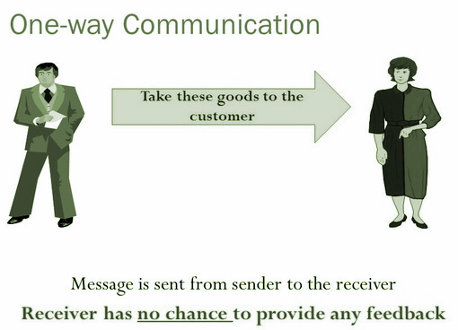
Effective Communication Models
One-way Communication (Transmission or Simplex) Model
Message from a sender to receiver/s only
Serves to inform, persuade, or command
No feedback from the receiver/s
Active sender but passive receiver
E.g. radio/tv broadcast

Slide 14
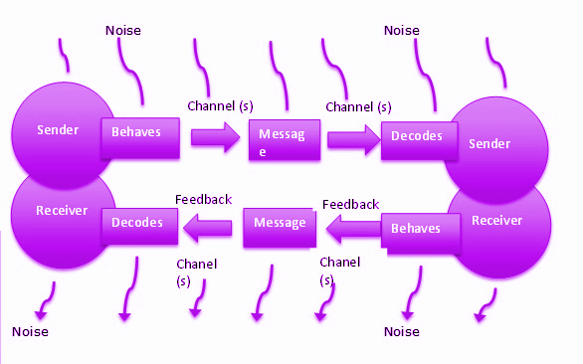
Effective Communication Models
Transactional Model (Half duplex)
Message from a sender to a receiver and vice-versa at a time
Serves to exchange information, or to persuade or command with the confirmation of receipt
Feedback is expected
Active sender is passive receiver, and passive sender is active receiver
E.g. walkie-talkie communication

Slide 15
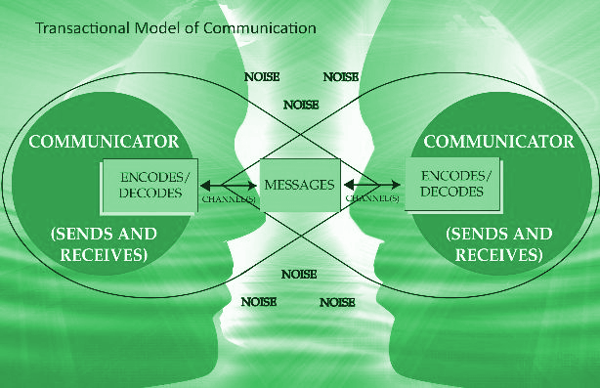
Effective Communication Models
Interactive Communication Model (full-duplex)
Message from a sender to receiver/s and vice-versa at the same time
Serves to exchange information, or to inform, persuade or command
Feedback is both ways
Active sender and active listener
E.g. sales meeting

Slide 16
Barriers to Effective Communication
Psychological or emotional Barrier
Semantic Barrier
Organizational Barrier
Personal Barrier
Within an organization, barriers such as hierarchy, policy or communication rules
Due to different meaning of words or symbols
Psychological or emotional state of a sender or receiver
Life experiences, cultural, religious differences

Slide 17


Depends on how you say it
“When are you going to complete your assignment?”
“When are you going to complete your assignment?”
“When are you going to complete your assignment?”
“When are you going to complete your assignment?”
Notes:
EM and SD

Slide 18
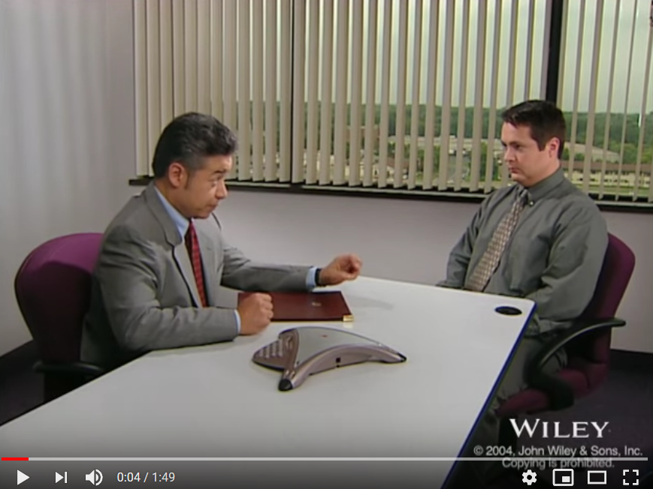
Ineffective Communication
https://www.youtube.com/watch?v=pKlx0ftlo-4

Slide 19
Effective Communication
Should be
Clear
Coherent
Complete
Courteous
Not vague or confusing
Logical, good flow
No vagueness or half baked
Respectful and positive

Slide 20

TCP 3-Way Handshake
https://www.youtube.com/watch?v=_vB-PvqYXfc

Slide 21
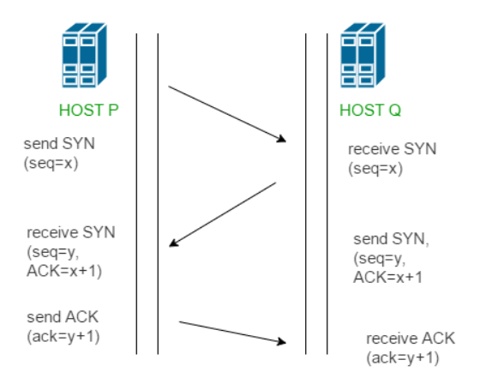
TCP 3-Way Handshake

Slide 22
Effective Communication
E.g. He has a heart of gold.
Denotation
Connotation
Literal or primary meaning
Abstract or secondary meaning

Slide 23
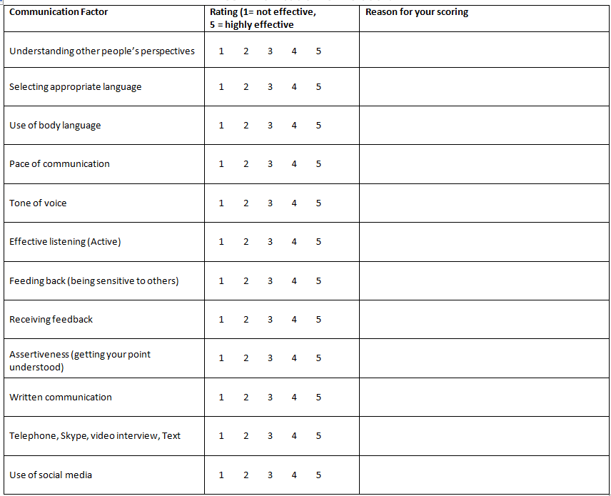
Communication Skills Audit

Slide 24
Thank you
Effective Communication

